Slide 1
DID NATIONAL HAPPINESS LEVELS IMPACT COVID-19 MORTALITY RATES IN 2020?
SYDNI PIERCE
ANTHONY KERINS

Slide 2
MOTIVATION AND SUMMARY
Hypothesis
Countries with higher pre-pandemic national happiness levels had lower COVID – 19 mortality rates in 2020, all else held constant
Questions
Did countries with higher pre-pandemic national happiness levels have lower COVID-19 mortality rates in 2020?
Which measures of national happiness/quality of life were most strongly correlated with COVID-19 mortality rates?
How does healthy life expectancy at birth factor into COVID-19 mortality rates?

Slide 3
QUESTIONS & DATA
FOCUS OF QUESTIONS
UNDERSTANDING HOW WORLD HAPPINESS WAS MEASURED
FOCUS ON WHAT FACTORS OF WORLD HAPPINESS/QUALITY OF LIFE HAD HIGHEST CORRELATION TO COVID-19 MORTALITY
UNDERSTANDING HOW MORTALITY RATES WERE MEASURED AND REPORTED
DATA
HTTPS://WORLDHAPPINESS.REPORT/ED/2021/
WORLD HAPPINESS REPORT 2020 DATA PANEL
WORLD COVID-19 MORTALITY DATA

Slide 4
DATA CLEANUP & EXPLORATION
Exploration and cleanup process
Pull 2019 happiness data for each country in survey from time series data file
Merge with Mortality Data for 2020
Investigate various COVID-19 mortality measures
Create histograms to show distribution of key measures
Explore correlation of national happiness with other quality of life measures
Explore correlation of different happiness/quality of life measures with COVID 19 death rate measures
Discuss insights you had while exploring the data that you didn't anticipate
Surprised by how many countries had low or zero COVID-19 deaths
National happiness demonstrates a moderate to high correlation with quality of life variables like GDP and life expectancy - how much of happiness is independent of these other factors?
Less developed countries fared far better in having lower COVID – 19 deaths
Historic methods of gathering happiness data had to be altered to accommodate pandemic concerns
Discuss any problems that arose after exploring the data, and how you resolved them
Due to methods of gathering data being changed by the pandemic, several measures were not able to be used as less than half of countries were able to gather the data
Concerns for the validity of data from some countries and was it possibly skewed
Present and discuss interesting figures developed during exploration using Jupyter Notebook

Slide 5
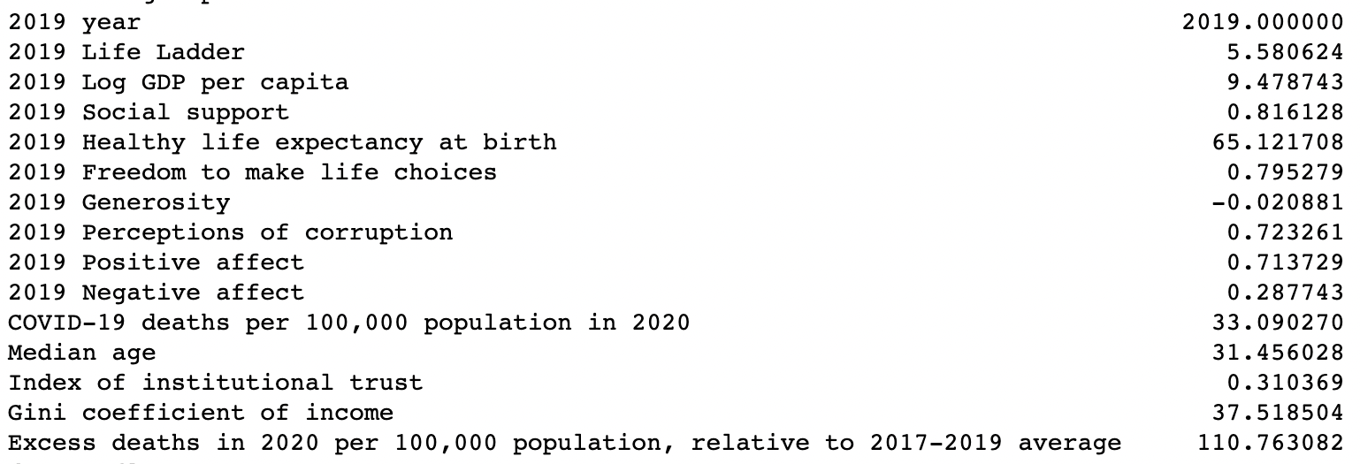
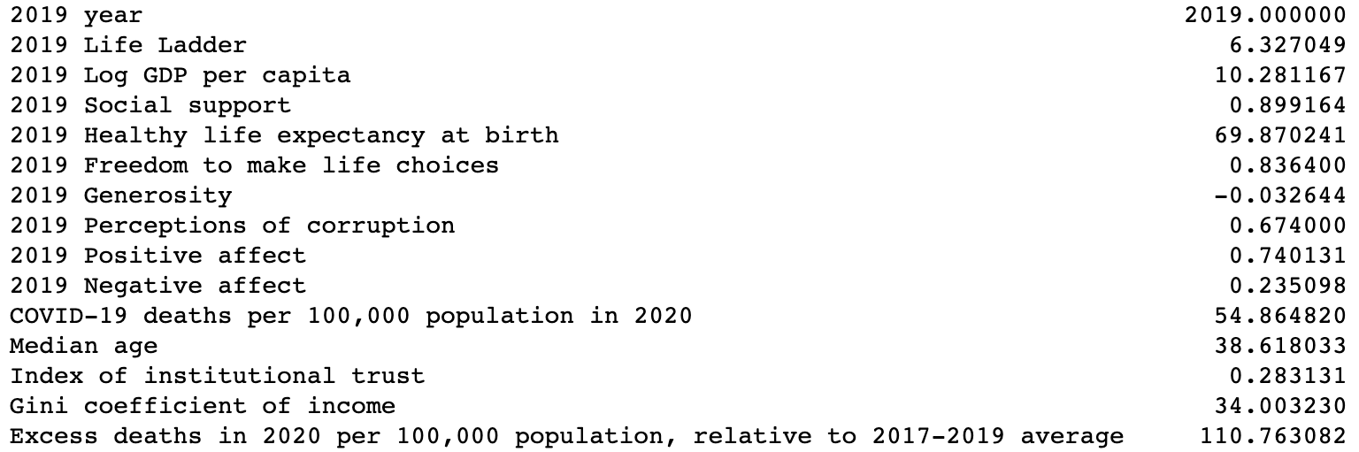
INVESTIGATING THE TWO COVID-19 DEATH METRICS
COVID-19 Deaths per 100k Population,
mean of other metrics
for all countries for which this data point is available
(141 countries represented)
Excess Deaths per 100k Population,
mean of other metrics
for all countries for which this data point is available
(61 countries)

Slide 6
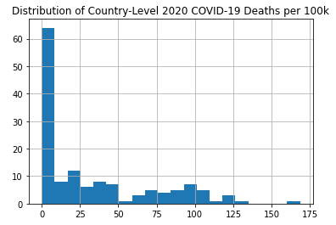
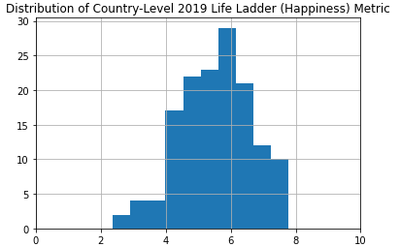
DISTRIBUTION OF KEY MEASURES
COVID -19 Deaths per 100,000 Population
Life Ladder (Happiness)

Slide 7
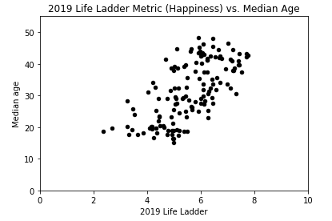
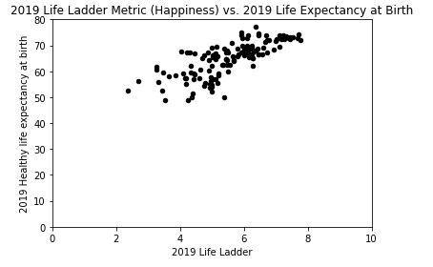
WHAT IS HAPPINESS?

Slide 8
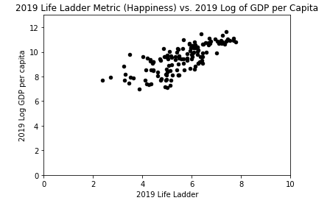
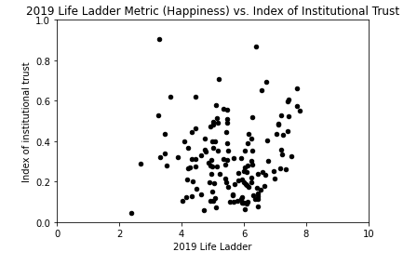
WHAT IS HAPPINESS?

Slide 9
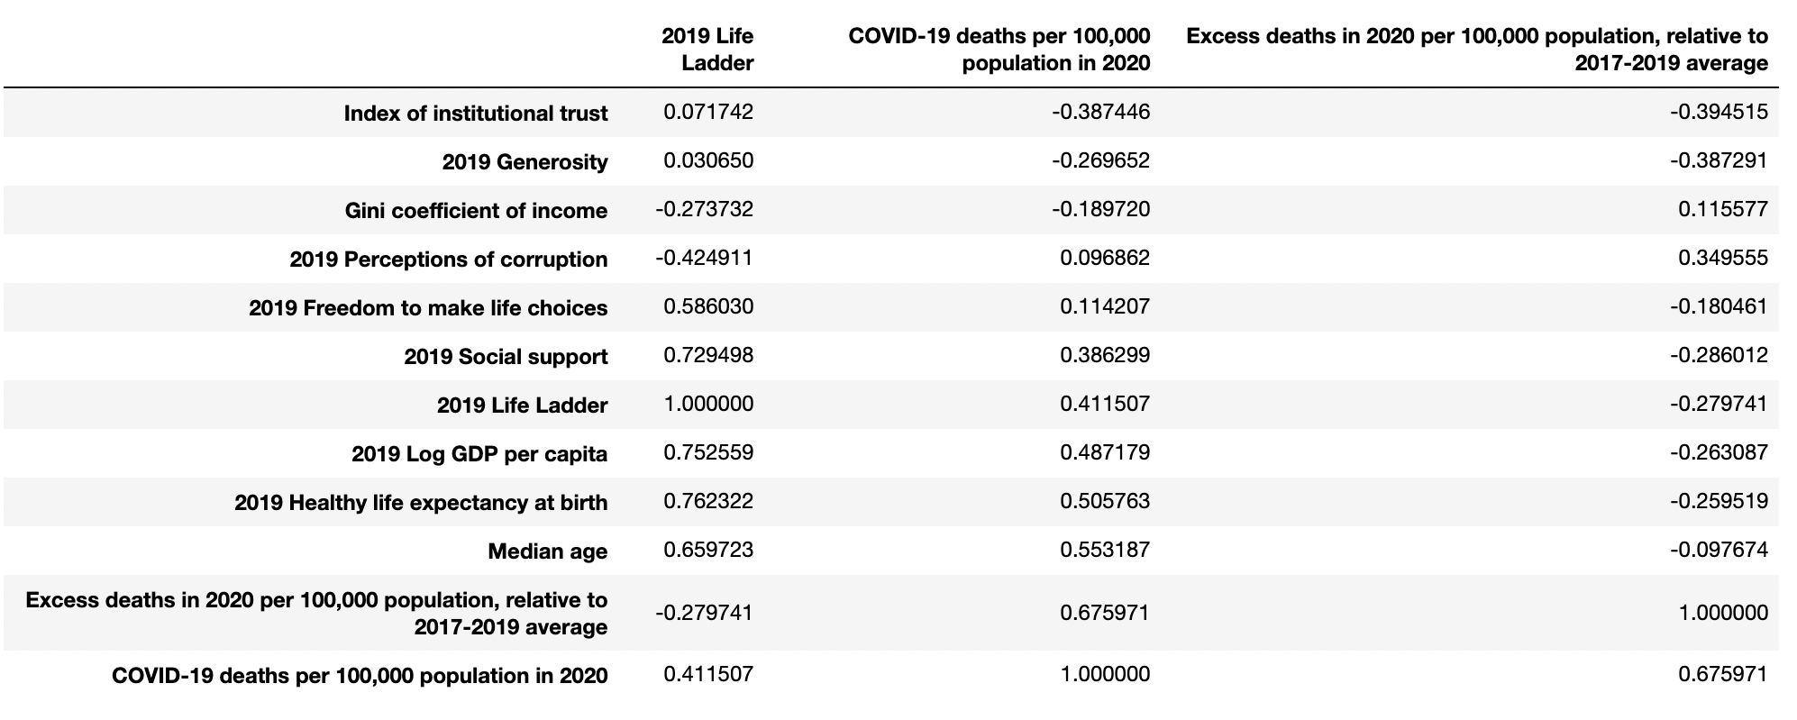
COVID-19 DEATHS CORRELATION MATRIX

Slide 10
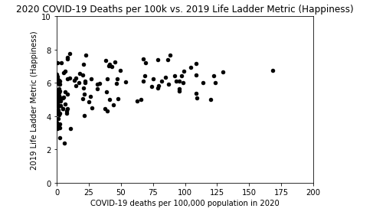
COVID-19 DEATHS PER 100,000 vs. NATIONAL HAPPINESS

Slide 11
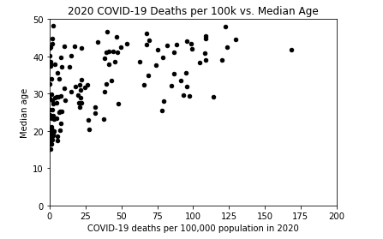
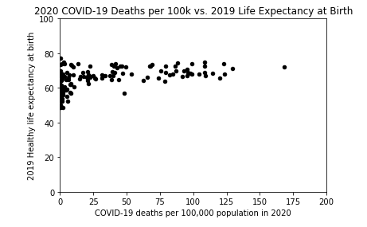
COVID-19 DEATHS PER 100,000 CORRELATIONS (OTHER QoL VARIABLES)

Slide 12
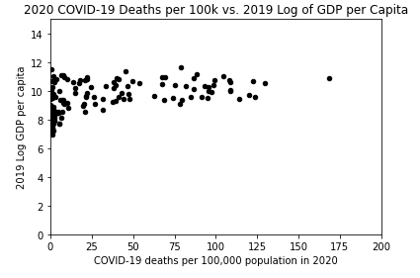
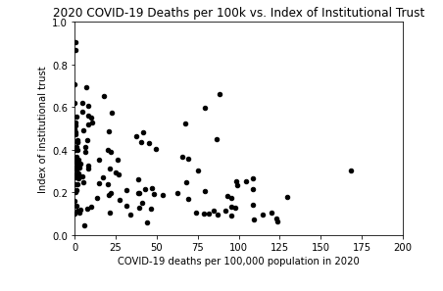
COVID-19 DEATHS PER 100,000 CORRELATIONS (OTHER QoL VARIABLES)

Slide 13
DISCUSSION
FINDINGS
We were unable to draw valid conclusions about correlations between variables that may suggest causal relationships due to the distribution of the COVID-19 death rate data. Linear statistical methods were not appropriate for this study.
We did not find there to be a strong correlation between higher levels of national happiness to lower levels of COVID – 19 deaths.
The greatest positive linear correlation of COVID – 19 mortality was with national median age followed closely by Healthy Life Expectancy. The greatest negative linear correlation was with institutional trust. These coefficients appear to show that where COVID-19 deaths are high, there is greater predictability in other metrics, but where COVID-19 deaths are low there is great variability/low predictability in other variables using a linear model.
Our overall finding was that countries with a higher level of happiness based on the survey measures did not have a significant difference in the level of deaths from COVID – 19. Our initial assumption was that countries with higher happiness levels would have a lower level of deaths per 100,000. The opposite proved to be true based on linear correlation coefficients. Could this be due to the fact that developed countries (remember, higher GDP appears to correlate strongly with higher levels of happiness) tend to experience greater global travel and have perhaps less experience battling pandemics, which allowed for greater exposure to the virus, which in turn led to higher levels of COVID – 19 deaths?

Slide 14
POST MORTEM
DIFFICULTIES
Both sets of data had information for over 144 countries, but certain variables were missing for a large of proportion of countries. We had to eliminate most of that information from our analysis as using these variables would have narrowed the sample in an unrepresentative/non-random way.
The levels of correlation needed to support a potential causal relationship with COVID-19 death rates did not exist for most of the happiness measures. We focused on the four measures that displayed the highest level of correlation.
ADDITIONAL QUESTIONS
We would have liked to have been able to take a deeper dive into the connection between lower death rates and what appeared to be lesser developed countries. Does it relate to international travel levels?
We would also have liked to have spent more time on the level of exposure on March 31 compared to the different happiness measures. We eliminated this as it did not correlate with our initial hypothesis.
If we could have another 2 weeks, we would likely spend more time researching outliers for the various measures and determining what effect, if any, they may have had on the independent measures.

Slide 15


